Slide 1
Section 5
Computer Graphics

Slide 2
glutReshapeFunc
Called back when the window first appears and whenever the window is re-sized with its new width and height.
Usage: glutReshapeFunc(Reshape);

Slide 3
gluPerspective
gluPerspective — set up a perspective projection matrix
Usage: gluPerspective( fovy, aspect, zNear, zFar);
fovy | Specifies the field of view angle, in degrees, in the y direction.
aspect | Specifies the aspect ratio that determines the field of view in the x direction. The aspect ratio is the ratio of x (width) to y (height).
zNear | Specifies the distance from the viewer to the near clipping plane (always positive).
zFar | Specifies the distance from the viewer to the far clipping plane (always positive)

Slide 4
glTranslatef
glTranslate produces a translation by x y z
Usage: glTranslatef(GLfloat x, GLfloat y,GLfloat z);
X | + right | - left
Y | + up | - down
Z | + zooming out toward the viewer | - into the screen

Slide 5
glRotatef
glRotate produces a rotation of angle degrees around the vector x y z
Usage: glRotatef( angle, x, y, z);
Angle: Specifies the angle of rotation, in degrees.
x, y, z: Specify the x, y, and z coordinates of a vector, respectively.

Slide 6
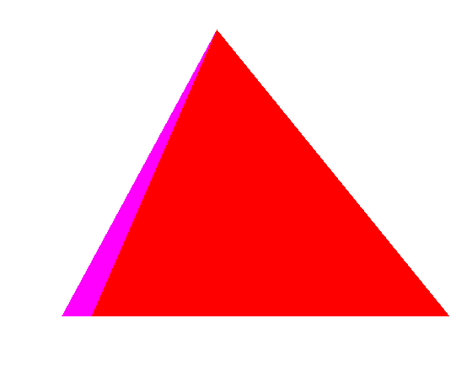
Draw this shape

Slide 7
#include <GL/glut.h> void initGL() { glClearColor(1.0f, 1.0f, 1.0f, 0.0f); glClearDepth(1.0f); glEnable(GL_DEPTH_TEST); glDepthFunc(GL_LEQUAL); } void display() { glClear(GL_COLOR_BUFFER_BIT | GL_DEPTH_BUFFER_BIT); glMatrixMode(GL_MODELVIEW); glLoadIdentity(); glTranslatef(1.5f, 1.0f, -5.0f); glBegin(GL_TRIANGLES); // Front glColor3f(1.0f, 0.0f, 0.0f); glVertex3f(0.0f, 1.0f, 0.0f);//1 | glVertex3f(-1.0f, -1.0f, 1.0f);//2 glVertex3f(1.0f, -1.0f, 1.0f);//3 // Right glColor3f(0.0f, 0.0f, 1.0f); glVertex3f(0.0f, 1.0f, 0.0f); //1 glVertex3f(1.0f, -1.0f, 1.0f);//3 glVertex3f(1.0f, -1.0f, -1.0f);//4 // Back glColor3f(0.0f, 1.0f, 0.0f); glVertex3f(0.0f, 1.0f, 0.0f);//1 glVertex3f(1.0f, -1.0f, -1.0f);//4 glVertex3f(-1.0f, -1.0f, -1.0f);//5 // Left glColor3f(1.0f, 0.0f, 1.0f); | glVertex3f(0.0f, 1.0f, 0.0f);//1 glVertex3f(-1.0f, -1.0f, -1.0f);//5 glVertex3f(-1.0f, -1.0f, 1.0f);//2 glEnd(); glutSwapBuffers(); } void reshape(GLsizei width, GLsizei height) { if (height == 0) height = 1; GLfloat aspect = (GLfloat)width / (GLfloat)height; glViewport(0, 0, width, height); glMatrixMode(GL_PROJECTION); glLoadIdentity(); gluPerspective(45.0f, aspect, 0.1f, 100.0f); } | int main(int argc, char** argv) { glutInit(&argc, argv); glutInitDisplayMode(GLUT_DOUBLE); glutInitWindowSize(640, 480); glutInitWindowPosition(200, 100); glutCreateWindow("3D Shapes"); initGL(); glutDisplayFunc(display); glutReshapeFunc(reshape); glutMainLoop(); return 0; }

Slide 8
Question
What happens if we changes this line:
glTranslatef(1.5f, 1.0f, -5.0f);
to: glTranslatef(-1.5f, 1.0f, -5.0f);
Or: glTranslatef(1.5f, -1.0f, -7.0f);

Slide 9
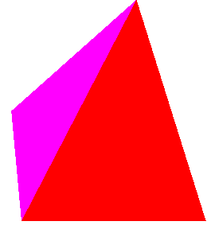
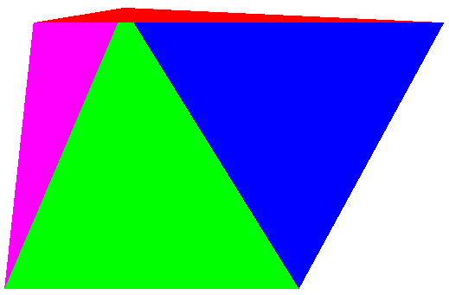
What happened ?
glRotatef(45, 1.0, 0.0,0.0); | glRotatef(45, -1.0, 0.0,0.0);

Slide 10
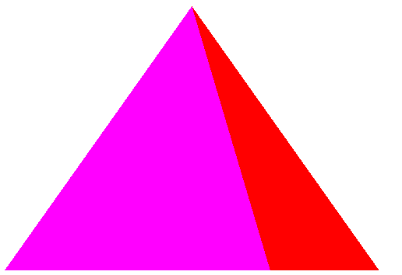
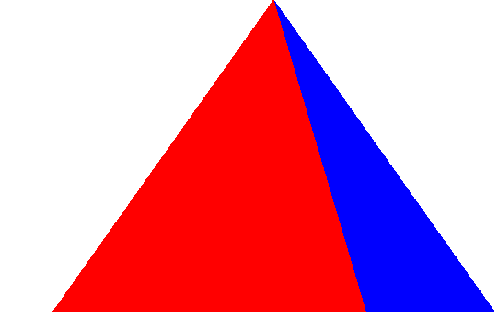
What happened ?
glRotatef(45, 0.0, 1.0,0.0); | glRotatef(45, 0.0, -1.0,0.0);

Slide 11
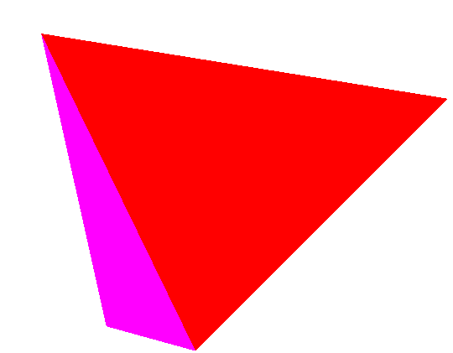
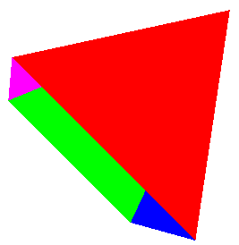
What happened ?
glRotatef(45, 0.0, 0.0,1.0); | glRotatef(45, 0.0, 0.0,-1.0);

Slide 12
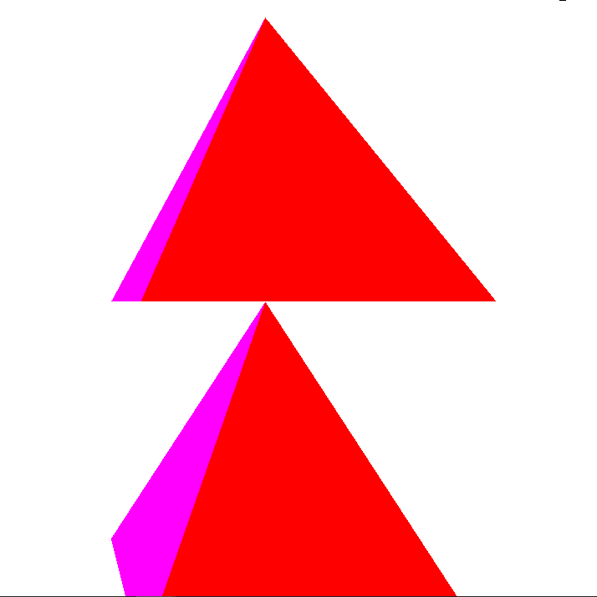
Draw this shape

Slide 13
#include <GL/glut.h> void initGL() { glClearColor(1.0f, 1.0f, 1.0f, 0.0f); glClearDepth(1.0f); glEnable(GL_DEPTH_TEST); glDepthFunc(GL_LEQUAL); } void display() { glClear(GL_COLOR_BUFFER_BIT | GL_DEPTH_BUFFER_BIT); glMatrixMode(GL_MODELVIEW); glLoadIdentity(); glTranslatef(1.5f, 1.0f, -5.0f); glBegin(GL_TRIANGLES); // Front glColor3f(1.0f, 0.0f, 0.0f); glVertex3f(0.0f, 1.0f, 0.0f);//1 glVertex3f(-1.0f, -1.0f, 1.0f);//2 glVertex3f(1.0f, -1.0f, 1.0f);//3 // Right glColor3f(0.0f, 0.0f, 1.0f); glVertex3f(0.0f, 1.0f, 0.0f); //1 glVertex3f(1.0f, -1.0f, 1.0f);//3 glVertex3f(1.0f, -1.0f, -1.0f);//4 // Back glColor3f(0.0f, 1.0f, 0.0f); glVertex3f(0.0f, 1.0f, 0.0f);//1 glVertex3f(1.0f, -1.0f, -1.0f);//4 glVertex3f(-1.0f, -1.0f, -1.0f);//5 // Left glColor3f(1.0f, 0.0f, 1.0f); glVertex3f(0.0f, 1.0f, 0.0f);//1 glVertex3f(-1.0f, -1.0f, -1.0f);//5 glVertex3f(-1.0f, -1.0f, 1.0f);//2 glEnd(); | glLoadIdentity(); glTranslatef(1.5f, -1.0f, -5.0f); glBegin(GL_TRIANGLES); // Front glColor3f(1.0f, 0.0f, 0.0f); glVertex3f(0.0f, 1.0f, 0.0f);//1 glVertex3f(-1.0f, -1.0f, 1.0f);//2 glVertex3f(1.0f, -1.0f, 1.0f);//3 // Right glColor3f(0.0f, 0.0f, 1.0f); glVertex3f(0.0f, 1.0f, 0.0f); //1 glVertex3f(1.0f, -1.0f, 1.0f);//3 glVertex3f(1.0f, -1.0f, -1.0f);//4 // Back glColor3f(0.0f, 1.0f, 0.0f); glVertex3f(0.0f, 1.0f, 0.0f);//1 glVertex3f(1.0f, -1.0f, -1.0f);//4 glVertex3f(-1.0f, -1.0f, -1.0f);//5 // Left | glColor3f(1.0f, 0.0f, 1.0f); glVertex3f(0.0f, 1.0f, 0.0f);//1 glVertex3f(-1.0f, -1.0f, -1.0f);//5 glVertex3f(-1.0f, -1.0f, 1.0f);//2 glEnd(); glutSwapBuffers(); } void reshape(GLsizei width, GLsizei height) { if (height == 0) height = 1; GLfloat aspect = (GLfloat)width / (GLfloat)height; glViewport(0, 0, width, height); glMatrixMode(GL_PROJECTION); glLoadIdentity(); gluPerspective(45.0f, aspect, 0.1f, 100.0f); } | int main(int argc, char** argv) { glutInit(&argc, argv); glutInitDisplayMode(GLUT_DOUBLE); glutInitWindowSize(640, 480); glutInitWindowPosition(200, 100); glutCreateWindow("3D Shapes"); initGL(); glutDisplayFunc(display); glutReshapeFunc(reshape); glutMainLoop(); return 0; }

